Slide 1
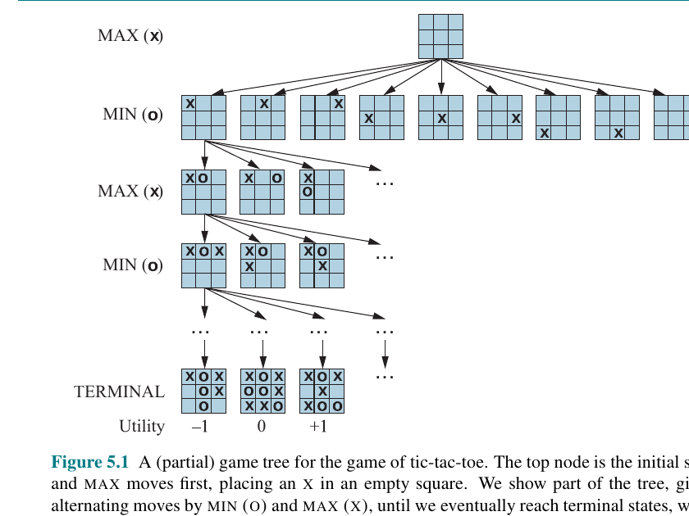
COMP 469
Chapter 5
Adversarial Search
and Games
How agents plan when another agent is trying to stop them
Includes minimax, alpha-beta pruning, heuristic game search, MCTS, stochastic games, partial observability, limitations, and teaching gotchas.
Full lecture deck with speaker notes
01
Notes:
Teaching move: Open by asking students to name a game where they can plan without worrying about an opponent, then one where the opponent actively adapts. This contrast is the heart of Chapter 5.
Analogy: In Chapter 3, search was like using GPS on a map. In Chapter 5, the map can fight back. Every path you choose gives the other side a chance to redirect the outcome.
Gotcha to flag early: A random event is not the same as an adversary. Rain does not try to beat you; a chess opponent does.

Slide 2
Lecture Roadmap
A full teaching path from game definitions to modern game-search limits.
1. Game setup
5. MCTS
Games as formal search problems: states, actions, result, terminal test, utility.
Replace expert evaluation with repeated simulations.
2. Minimax
6. Chance and hidden info
Optimal decisions when MAX and MIN both reason perfectly.
Expectiminimax, belief states, poker-like uncertainty.
3. Alpha-beta
7. Limits and labs
Search the same answer while skipping irrelevant branches.
Horizon effect, forward pruning, exploitability, class demos.
4. Heuristics
Cut off deep search and estimate who is winning.
The core question: What should I do when someone else is choosing what happens next?
Anchor every algorithm to this question.
COMP 469 | Adversarial Search and Games
Lecture Roadmap
02
Notes:
Use this as the pacing map. Students can feel lost because Chapter 5 contains many algorithms. Keep returning to one simple question: if another agent can choose outcomes against me, how do I decide?
Teaching note: Tell students the chapter is not only about games. Games are clean laboratories for multi-agent decision making, negotiation, security, auctions, robot teams, and adversarial ML.
Gotcha: Do not let students think minimax is only for tic-tac-toe. Tic-tac-toe is the microscope; the concepts scale to much harder domains.

Slide 3
What Students Should Be Able To Do
By the end, students should be able to explain the algorithm, trace it, and choose when to use it.
Define the game
Trace the search
Handle real limits
• State the formal game components
• Distinguish state space graph vs. search tree
• Explain zero-sum and perfect-information assumptions
• Back up minimax values
• Identify MAX and MIN levels
• Explain why alpha-beta prunes safely
• Use cutoff search and EVAL
• Explain quiescence and horizon effects
• Compare alpha-beta and MCTS
Generalize
Teach-back target
• Extend to multiplayer utilities
• Model chance with expectiminimax
• Reason over belief states in partially observable games
A student should be able to draw a small game tree and explain every number that appears on it.
COMP 469 | Adversarial Search and Games
Learning Outcomes
03
Notes:
Tell students that this chapter has three levels of mastery. First, vocabulary: MAX, MIN, utility, terminal, alpha, beta. Second, tracing: can they compute the numbers on a tree? Third, engineering judgment: can they choose minimax, alpha-beta, heuristic search, MCTS, or belief-state reasoning for a given game?
Analogy: Vocabulary is knowing the pieces on a chess board. Tracing is playing a legal game. Engineering judgment is choosing a strategy under a clock.
Gotcha: Students often memorize the pseudocode without understanding what the numbers mean. Emphasize that every backed-up value is a promise about what optimal play will force.

Slide 4
Why Games Are a Perfect AI Laboratory
Games strip away messy physics while keeping strategic difficulty.
Precise rules
Conflicting goals
Huge search spaces
The legal actions and consequences are usually well-defined, so we can focus on reasoning rather than perception.
Another agent is not random noise: it actively tries to choose outcomes that hurt our utility.
Even simple rules produce enormous trees. This forces us to confront pruning, heuristics, and approximation.
Games let us study intelligence under pressure.
Clear rules + opponent + limited time = AI design stress test.
Tic-tac-toe: small rules, large tree
COMP 469 | Adversarial Search and Games
Motivation
04
Notes:
Start with familiar games: tic-tac-toe, Connect Four, chess, Go, poker. Ask: Which are fully observable? Which include chance? Which require bluffing?
Analogy: Games are like wind tunnels for AI. Airplane engineers do not begin by flying into a hurricane; they test principles in controlled conditions. Game AI does the same for decision making.
Gotcha: A game can be easy for humans but hard computationally. Students should not equate familiarity with algorithmic simplicity.

Slide 5
Chapter 5 Concept Map
Each section relaxes one simplifying assumption.
5.1 Game theory
5.2 Optimal decisions
Define adversarial environments and game components.
Minimax and multiplayer utility vectors.
5.2.3-5.2.4 Pruning
5.3 Heuristic search
Alpha-beta and move ordering.
Cutoff tests, evaluation functions, horizon effect.
5.4 MCTS
5.5 Stochastic games
Selection, expansion, simulation, backpropagation.
Chance nodes and expectiminimax.
5.6-5.7 Hidden info and limits
Belief states, approximation traps, forward pruning.
COMP 469 | Adversarial Search and Games
Chapter Map
05
Notes:
Use this to show the chapter's progression. First we assume deterministic, two-player, zero-sum, turn-taking, perfect-information games. Then the chapter broadens: multiple players, time limits, chance events, hidden information, and algorithmic limits.
Teaching note: Keep writing the assumptions on the board. Students understand the algorithms better when they see which assumption each one depends on.
Gotcha: Minimax is not wrong when assumptions fail; it is just solving a different problem than the one you actually have.

Slide 6
Rain Is Not an Opponent
Nondeterminism is not the same as adversarial behavior.
Random environment
Adversarial agent
Teaching analogy
• Rain may fall or not fall
• Dice may land on any face
• No intention to defeat you
• Opponent observes or infers your choices
• Opponent selects actions to reduce your outcome
• Your plan must anticipate counter-moves
Planning a picnic vs. playing chess. Weather can ruin your picnic, but it is not studying your strategy. A chess opponent is.
A game tree alternates decisions because control alternates between agents.
MAX chooses, then MIN chooses, and the value flows backward.
COMP 469 | Adversarial Search and Games
Game Theory
06
Notes:
Ask students: Is a slot machine adversarial? Is poker adversarial? Is traffic adversarial? This opens discussion about modeling choices. Traffic may contain many agents, but sometimes we model it statistically; other times we model strategic drivers explicitly.
Analogy: Rain is uncertainty. An opponent is uncertainty with goals.
Gotcha: Students may say 'MIN is random.' In minimax, MIN is not random; MIN is assumed to choose the move that is worst for MAX.

Slide 7
Three Stances Toward Multi-Agent Environments
Chapter 5 chooses the third stance: model the adversary explicitly.
1. Aggregate economy
2. Nondeterministic environment
3. Adversarial search
When there are many agents, we may model them statistically: supply, demand, market flow, congestion.
Treat other agents as unpredictable parts of the world. Useful, but it hides their strategic intent.
Model opponents as agents making choices that oppose our objective. This produces game trees.
Class prompt: For each example, choose a stance: stock market, self-driving car traffic, chess, poker, auction bidding.
COMP 469 | Adversarial Search and Games
Game Theory
07
Notes:
Explain that modeling is a design choice, not a law of nature. In some contexts, another person is best modeled statistically; in others, strategically.
Teaching activity: Put five examples on the board and ask students to classify them. Then challenge classifications. Example: traffic can be aggregate flow, nondeterministic noise, or multi-agent strategy depending on the goal.
Gotcha: The agent's model does not have to represent every real-world detail. It only needs enough structure to choose actions effectively.

Slide 8
The Classic Game Class
Most Chapter 5 algorithms begin with a restricted but important class of games.
Deterministic
Two-player
Turn-taking
Perfect information
No dice or random transitions once an action is chosen.
Exactly MAX and MIN take turns.
Only one player chooses at a time.
The full state is visible to both players.
Zero-sum
Examples
What helps MAX hurts MIN by the same amount.
• Tic-tac-toe
• Chess
• Checkers
• Go
Start simple, then add realism.
Later slides add multiplayer utility, chance, and hidden information.
COMP 469 | Adversarial Search and Games
Two-Player Zero-Sum Games
08
Notes:
This slide names the assumptions students should memorize. Write them as a checklist. For any game, students can ask: deterministic? two-player? turn-taking? perfect information? zero-sum?
Analogy: These assumptions are like lab conditions. We start in a clean lab before moving to the messy field.
Gotcha: Perfect information does not mean the future is known. It means the current state is fully observable.

Slide 9
Formal Game Definition: The API
Every adversarial search algorithm needs these functions.
S0
TO-MOVE(s)
ACTIONS(s)
Initial state
Whose turn?
Legal moves
RESULT(s,a)
IS-TERMINAL(s)
UTILITY(s,p)
Next state
Game over?
Final value for player p
Think like a programmer: if you can implement these six functions, you can plug a game into minimax or alpha-beta.
COMP 469 | Adversarial Search and Games
Game Definition
09
Notes:
Tie this directly to students' Python labs. A Game class usually has methods actions(state), result(state, action), terminal(state), utility(state, player), and to_move(state).
Analogy: This API is the contract between the game rules and the search algorithm. The search algorithm does not need to know what a rook or a checker is; it only asks for legal actions and resulting states.
Gotcha: UTILITY is for terminal states. A heuristic EVAL is for non-terminal states when we cut off search early.

Slide 10
State-Space Graph vs. Game Tree
The graph is the world; the tree is our lookahead from the current state.
State-space graph
Search tree
Transposition
• Nodes are unique game states
• Edges are legal moves
• A state can be reached by multiple paths
• Root is current state
• Each path is a move sequence
• Same state may appear many times as different tree nodes
Different move orders can produce the same state. Caching such states prevents duplicate work.
A
B
C
D
Graph: shared states
Tree: repeated paths
COMP 469 | Adversarial Search and Games
Game Definition
10
Notes:
Students often confuse these. The game rules define a graph of states. The algorithm builds a tree of possible futures from where we are now.
Analogy: The city road map is a graph. Your GPS route exploration from home is a tree of possible trips. The same intersection can appear in many planned routes.
Gotcha: A search node is not necessarily a unique state. It is a path plus a state. This matters for repeated states and transposition tables.

Slide 11
Tic-Tac-Toe: A Complete Game Tree in Miniature
The tree alternates MAX placing X and MIN placing O until terminal utilities.
How to read it
• Root = empty board
• Each layer = one ply
• Leaves = terminal states
• Numbers = utility for MAX
Teaching move
Have students follow one path from the root to a terminal board and label who moved at each layer.
Chapter 5 Figure 5.1: partial tic-tac-toe game tree
COMP 469 | Adversarial Search and Games
Game Trees
11
Notes:
Use this slide slowly. Point to the root, then one child, then one grandchild. Ask students: whose turn is it on each level? What does a leaf utility mean?
Analogy: The tree is a script of all possible conversations between two players. MAX says one move, MIN replies, MAX replies, and so on.
Gotcha: The utility is from MAX's perspective unless otherwise stated. A value of -1 is not 'bad for both'; it is bad for MAX and good for MIN.

Slide 12
Small Rules, Huge Trees
The enemy is the exponent.
Tic-tac-toe
Chess
< 9! terminal paths
small enough to teach
branching ~35, depth ~80
far beyond full minimax
Go
Poker
branching can be hundreds
evaluation is very hard
hidden information + chance
state is uncertain
Full-width search is a theoretical ideal, not a practical plan.
Real game AI survives by pruning, estimating, sampling, or learning.
COMP 469 | Adversarial Search and Games
Complexity
12
Notes:
Give a quick calculation: if each position has 10 legal moves and you look ahead 6 ply, that is roughly one million leaves. Then raise branching factor to chess-like values.
Analogy: Searching a game tree is like asking 'what if?' repeatedly. A few 'what ifs' are easy; millions are not.
Gotcha: Students may think faster computers solve the whole problem. Exponential growth usually outruns hardware improvements.

Slide 13
MAX and MIN: Two Roles, One Utility Scale
MAX wants high values; MIN wants low values.
MAX
MIN
Analogy
• The player we are choosing a move for
• Prefers larger utility
• At MAX nodes: take max of successors
• The opponent in a zero-sum game
• Prefers smaller utility for MAX
• At MIN nodes: take min of successors
MAX is choosing a route. MIN is a hostile road manager who gets to close one road after seeing your direction.
MIN is not evil in general. MIN is just optimizing the opposite objective.
In zero-sum games, one utility scale is enough.
COMP 469 | Adversarial Search and Games
Minimax
13
Notes:
Clarify that MAX and MIN are roles, not moral labels. MAX is the player whose utility scale we are using. MIN's utility is the negative or opposite.
Analogy: In a debate tournament, your opponent is not 'evil' for refuting your argument. Their objective conflicts with yours.
Gotcha: Some students think MIN chooses the smallest number for itself. In zero-sum form, the numbers shown are for MAX, so MIN chooses the smallest MAX number.

Slide 14
Utility Values: What the Leaves Mean
Utilities are final payoffs, not feelings and not probabilities unless defined that way.
Terminal utility
Zero-sum shortcut
Important distinction
A number assigned when the game is over. Examples: win = +1, draw = 0, loss = -1 from MAX perspective.
Instead of two values, one value is enough because MIN wants the opposite of MAX.
A high score means good for MAX. It does not mean high confidence unless the score has been calibrated to probabilities.
Win/loss utility example: MAX win = +1, draw = 0, MAX loss = -1
Chess-style heuristic example: +3 means roughly a knight advantage, not a guaranteed win.
COMP 469 | Adversarial Search and Games
Utility
14
Notes:
This slide prevents later confusion about evaluation functions. Terminal utility is exact. Heuristic evaluation is an estimate.
Analogy: Utility is the scoreboard after the game ends. A heuristic is the commentator saying who looks ahead before the game is over.
Gotcha: Students often treat all values as probabilities. In minimax, any ordered utility scale can work. In expectiminimax, the scale matters because averages are computed.

Slide 15
A Strategy Is More Than One Move
In adversarial search, a plan must respond to opponent choices.
Move
Strategy
Why it matters
A single action chosen now: place X in the center, move knight to f3, bet, fold.
A conditional plan: if MIN replies this way, do A; if MIN replies that way, do B.
MAX cannot pick the whole future alone. The future is co-authored by MAX and MIN.
Minimax chooses a move by imagining the best complete strategy after that move.
One move now is evaluated through all possible replies.
COMP 469 | Adversarial Search and Games
Strategy
15
Notes:
Use a chess opening example. A move like e4 is not just a move; it opens a family of responses depending on what Black does.
Analogy: It is like planning a conversation with a difficult interviewer. You prepare branches: if they ask about project A, I answer this; if they challenge method B, I answer that.
Gotcha: Do not say minimax 'predicts' the exact opponent move. It assumes the opponent will choose the reply that leads to the lowest MAX utility.

Slide 16
SECTION 5.2
Optimal Decisions in Games
Minimax search: reason from terminal utilities back to the current move.
Core object
Core operation
Core question
A game tree with alternating MAX and MIN layers.
Back up values using max and min.
What value can MAX guarantee?
COMP 469 | CSU Channel Islands
16
Notes:
Transition note: Students now have the formal game setup. This section answers how to choose an optimal move.
Teaching analogy: Think of minimax as a debate tree where each side picks the strongest response available to them.
Gotcha: The word optimal always assumes a model of the opponent. Here the model is: the opponent plays optimally to minimize MAX's utility.

Slide 17
The Minimax Question
If both players play optimally from here, what value can MAX force?
MINIMAX(s) = utility of state s under optimal play by both sides.
Work from terminal leaves back to the root.
Terminal state
MAX to move
MIN to move
Return UTILITY(s, MAX).
Return the maximum minimax value among successors.
Return the minimum minimax value among successors.
Teaching phrase: “At MAX levels, lift the highest child. At MIN levels, sink to the lowest child.”
COMP 469 | Adversarial Search and Games
Minimax
17
Notes:
This is the slide students should remember. The definition is recursive and simple.
Analogy: Imagine each node asking its children, 'What score will happen from you?' MAX picks the loudest good news; MIN picks the worst news for MAX.
Gotcha: Emphasize that values are backed up from the leaves. We do not know the root value until enough descendant values have been evaluated.

Slide 18
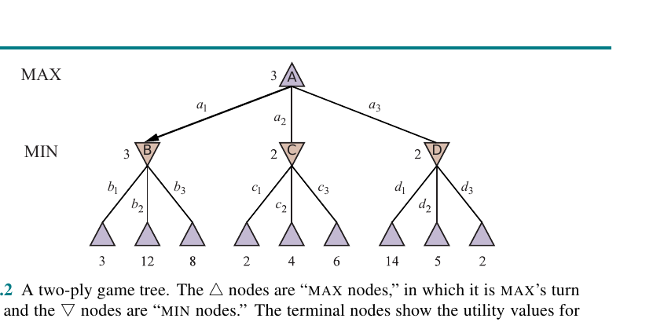
Two-Ply Minimax Example
MAX chooses an action, then MIN chooses a reply.
Read the tree
• Root A is MAX
• B, C, D are MIN nodes
• Leaves are utilities for MAX
• Back up values: B=3, C=2, D=2, A=3
Result
MAX chooses a1 because it leads to B, whose minimax value is 3. MIN would then choose b1.
Chapter 5 Figure 5.2: two-ply game tree
COMP 469 | Adversarial Search and Games
Minimax Example
18
Notes:
Walk through the figure exactly. Ask: Why is B worth 3 instead of 12? Because MIN gets to choose among B's children. Why is A worth 3? Because MAX chooses among B, C, and D.
Analogy: Each parent lets the player to move pick the child that best serves that player's goal.
Gotcha: Students may incorrectly average the leaves. Minimax does not average; it assumes strategic choice, not random choice.

Slide 19
Step 1: Evaluate the Leaves
The recursion hits terminal states first.
A
?
What happens first?
• Search descends depth-first
• At a terminal node, call UTILITY
• Return each leaf value upward
B
?
C
?
D
?
Instructor prompt
3
12
8
2
4
6
14
5
2
Ask students to circle only the terminal utilities before calculating any parent values.
Terminal utilities
COMP 469 | Adversarial Search and Games
Minimax Trace
19
Notes:
Do not rush to the root. Force the class to start at the leaves. This develops the right mental model for recursive algorithms.
Analogy: You cannot grade a tournament bracket until the games at the bottom have scores.
Gotcha: Students often try to choose root action immediately by looking at the largest leaf, e.g., 14. That is wrong because MIN may prevent that leaf.

Slide 20
Step 2: MIN Nodes Choose the Worst for MAX
Each MIN node takes the minimum of its children.
A
3
MIN backups
• B = min(3,12,8) = 3
• C = min(2,4,6) = 2
• D = min(14,5,2) = 2
B
3
C
2
D
2
Why?
3
12
8
2
4
6
14
5
2
Because the values are for MAX, and MIN wants MAX to get as little as possible.
Terminal utilities
COMP 469 | Adversarial Search and Games
Minimax Trace
20
Notes:
Emphasize perspective. The number at a MIN node is not what MIN 'gets' if they have a separate utility scale. It is the resulting MAX value after MIN chooses.
Analogy: MIN is the gatekeeper who sends MAX down the least favorable hallway.
Gotcha: Students may select 12 under B because it is the largest leaf. Ask: who moves at B? MIN, not MAX.

Slide 21
Step 3: MAX Chooses the Best Guaranteed Outcome
At the root, MAX takes the maximum of backed-up child values.
A
3
Root backup
A = max(B, C, D) = max(3, 2, 2) = 3
B
3
C
2
D
2
Decision
Choose action a1. It is not the branch with the largest leaf, but it has the best value after MIN replies optimally.
3
12
8
2
4
6
14
5
2
Terminal utilities
COMP 469 | Adversarial Search and Games
Minimax Trace
21
Notes:
Ask students why action a3 is not selected despite having a leaf value of 14. The answer is that MIN can reply to force value 2.
Analogy: A tempting path with a hidden trap is not a guaranteed win. Minimax values guarantees under adversarial response.
Gotcha: The chosen move is not necessarily the move with the best possible outcome; it is the move with the best worst-case outcome against optimal opposition.

Slide 22
Mini-Exercise: Back Up This Tree
Students solve before you reveal.
?
?
Student task
• Compute each MIN node
• Compute the MAX root
• Name the optimal root move
• Explain why the biggest leaf is not enough
L
?
M
?
R
?
Instructor note
-2
4
7
1
3
5
9
0
2
Give 2 minutes. Then ask a student to narrate the backup process from leaves upward.
COMP 469 | Adversarial Search and Games
Activity
22
Notes:
Run this as a quick retrieval practice. Have students work individually first, then compare with a neighbor.
Suggested answer: left MIN = -2, middle MIN = 1, right MIN = 0, root MAX = 1, choose the middle branch.
Gotcha: If a student picks 9 because it is the largest leaf, ask them which player controls the parent of that leaf.

Slide 23
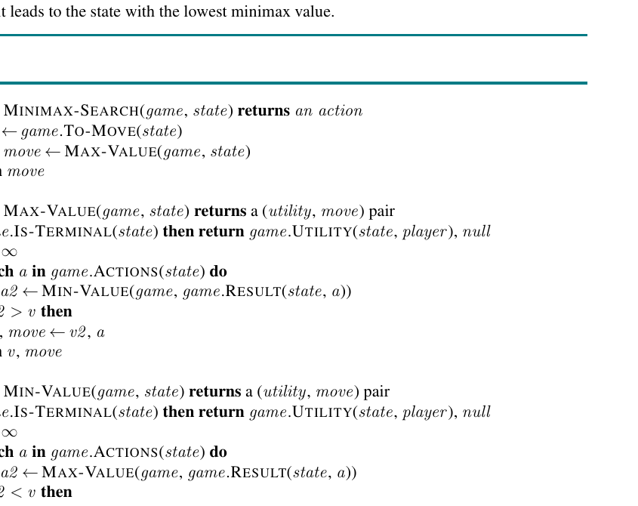
Minimax Search Pseudocode
The implementation is just recursive backup with alternating roles.
Code reading checklist
Python lab connection
• Base case: terminal state returns utility
• MAX loop keeps highest value
• MIN loop keeps lowest value
• Return both value and move
Students will see this as recursive functions or as a method that passes player, depth, and state.
Teaching gotcha
The recursion returns values up the tree. The move returned at the root is the action associated with the best backed-up value.
Chapter 5 Figure 5.3: minimax search algorithm
COMP 469 | Adversarial Search and Games
Algorithm
23
Notes:
Use the image for algorithmic structure, not for line-by-line memorization. Students should identify base case, recursive call, comparison, and returned move.
Analogy: A recursive search is like sending scouts down every path. Each scout reports a score back to the parent. The parent chooses according to whose turn it is.
Gotcha: A frequent bug is using max at every level. That makes the opponent cooperate, which is not adversarial search.

Slide 24
Minimax Complexity
Complete search is exact but exponential.
Time
Space
Interpretation
O(b^m)
b = legal moves per state
m = maximum depth in ply
O(m) if actions are generated one at a time; O(bm) if all actions are stored.
The tree grows by multiplying the branching factor at every ply.
Example growth with b = 3
1
3
9
27
81
243
d=0
d=1
d=2
d=3
d=4
d=5
COMP 469 | Adversarial Search and Games
Complexity
24
Notes:
This is a key reality check. Even if each node is cheap, the number of nodes explodes quickly.
Analogy: If every decision gives three new roads, six decisions later you have 729 possible paths if you count all complete paths. That explosion is why we need pruning and heuristics.
Gotcha: Students may focus on depth only. Branching factor matters just as much. Go is hard not because games are long only, but because there are many legal moves.

Slide 25
Optimal Against Whom?
Minimax assumes an optimal opponent, but real opponents may be imperfect.
Minimax guarantee
Human opponent
Risky play
Against perfect MIN, MAX can guarantee the minimax value.
If MIN makes mistakes, MAX may do better than the minimax guarantee.
Sometimes a risky move wins often against weak players but loses against a perfect one.
Teaching example: A move that guarantees a draw may be objectively safe; a trap move may have a higher expected payoff against a beginner.
Takeaway
Minimax is conservative: it optimizes the guaranteed value, not necessarily the best exploitative strategy against a known weak opponent.
COMP 469 | Adversarial Search and Games
Strategy
25
Notes:
This is a great discussion slide. Ask students whether they should play the same way against a grandmaster and a beginner.
Analogy: In tennis, a safe strategy against a pro may not exploit a beginner's weak backhand.
Gotcha: Do not present minimax as a model of human psychology. It is a worst-case strategic model.

Slide 26
Optimal Decisions in Multiplayer Games
The single utility value becomes a vector of utilities.
Two-player zero-sum
Three-player game
New behavior
One number is enough: if MAX gets +3, MIN is worse by the corresponding amount.
Terminal state returns a vector: <vA, vB, vC>. Each player chooses the successor best for itself.
Alliances and cooperation can emerge from selfish utility maximization.
At a C node, choose the child with the highest C component, not the highest A component.
COMP 469 | Adversarial Search and Games
Multiplayer Games
26
Notes:
Explain with a simple vector. If C chooses between <1,2,6> and <4,2,3>, C chooses the first because 6 > 3, even though A would prefer the second.
Analogy: In a group project negotiation, every person has their own scoreboard. A move that helps one player may be neutral or harmful to others.
Gotcha: Do not collapse multiplayer games into simple MAX/MIN unless there is a true zero-sum structure.

Slide 27
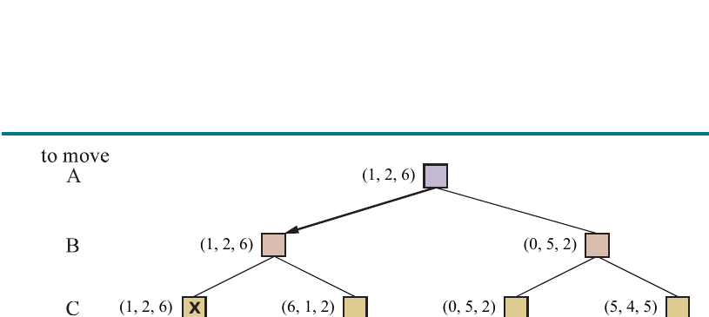
Utility Vectors: Reading the Multiplayer Tree
Each backed-up value is the vector chosen by the player to move.
How to narrate it
• Identify player to move at the current level
• Compare only that player’s component
• Back up the entire utility vector
Example
Chapter 5 Figure 5.4: three-player game tree
If C chooses between <1,2,6> and <4,2,3>, C chooses <1,2,6>. The entire vector backs up.
COMP 469 | Adversarial Search and Games
Multiplayer Games
27
Notes:
Use this figure to show that the generalization is technically simple but conceptually richer.
Teaching move: Pick one internal node and ask which component students should compare.
Gotcha: Students may compare the sum of utilities. That is not the default. Each player chooses according to their own utility component unless the game explicitly defines a social welfare objective.

Slide 28
Alliances Can Emerge from Selfish Play
Multiplayer games are not just larger minimax games.
Weak players align
Alliance instability
Social layer
If A and B are weak while C is strong, both may attack C because it improves their own survival chances.
Once C weakens, A and B may no longer have the same incentive to cooperate.
Promises, reputation, and trust can change optimal behavior in repeated human settings.
Collaboration can be a consequence of individual optimization.
But alliances may dissolve when utilities change.
COMP 469 | Adversarial Search and Games
Multiplayer Games
28
Notes:
This slide helps students connect game search to game theory. Alliances are not magic; they can fall out of utility structures.
Analogy: In a board game, two losing players may both target the leader. They are not being altruistic; they are preventing the leader from running away with the game.
Gotcha: A coalition is not guaranteed to be stable. The algorithmic model needs a way to represent agreements or repeated-game effects if those matter.

Slide 29
Non-Zero-Sum: Not Every Game Has One Winner
Some actions can help multiple players at once.
Zero-sum
Non-zero-sum
AI lesson
Your gain is exactly my loss. Chess and tic-tac-toe are modeled this way.
Both players can prefer the same outcome, or both can be harmed by conflict.
The utility function defines what “rational” means. Change utilities, change behavior.
Example: <1000,1000> can make cooperation rational even with two players.
COMP 469 | Adversarial Search and Games
Multiplayer Games
29
Notes:
This is a bridge to AI safety and multi-agent systems. If the utility structure permits win-win outcomes, rational agents may cooperate.
Analogy: Two students sharing notes for a quiz can both benefit; this is not zero-sum. But two candidates competing for one job may be closer to zero-sum.
Gotcha: Do not assume 'adversarial' means every interaction is pure conflict. The utility model defines conflict or cooperation.

Slide 30
SECTION 5.2.3
Alpha-Beta Pruning
Compute the same minimax decision while proving that some branches are irrelevant.
alpha
beta
prune
Best lower bound MAX has found.
Best upper bound MIN has found.
Stop when a branch cannot change the root choice.
COMP 469 | CSU Channel Islands
30
Notes:
Transition note: After students see minimax's exponential cost, alpha-beta feels like relief. Emphasize that it is exact pruning, not a heuristic shortcut.
Analogy: Alpha-beta is like refusing to investigate options that have already failed a necessary condition.
Gotcha: Pruning savings are highly dependent on move ordering.

Slide 31
Alpha-Beta Pruning: Same Answer, Less Search
Prune branches that cannot change the root decision.
Minimax problem
Alpha-beta idea
Safe pruning
Complete search examines every relevant node down to the depth limit.
While searching, maintain bounds on what MAX and MIN can already guarantee.
If a branch is already worse than a known alternative, stop exploring it.
Do not search a branch after you know nobody rational will choose it.
That is the entire intuition.
COMP 469 | Adversarial Search and Games
Alpha-Beta Pruning
31
Notes:
This is the most important intuition for alpha-beta. It does not guess. It skips only branches that cannot affect the optimal minimax decision.
Analogy: Shopping for the cheapest flight: once you find a flight for $300, you do not need to fully examine an itinerary that already costs $500 before adding taxes.
Gotcha: Alpha-beta pruning does not change the minimax value. If it does, the implementation has a bug.

Slide 32
Alpha and Beta Are Bounds
Think: alpha = at least; beta = at most.
alpha
beta
The best value MAX can guarantee so far along the current path.
Think: “MAX has an option worth at least alpha.”
The best value MIN can guarantee so far along the current path.
Think: “MIN can hold MAX to at most beta.”
Prune when alpha >= beta: the current branch cannot improve the final choice.
COMP 469 | Adversarial Search and Games
Alpha-Beta Pruning
32
Notes:
Say alpha and beta out loud several times: alpha means MAX's current best lower bound. Beta means MIN's current best upper bound.
Analogy: Alpha is MAX's reservation value. Beta is MIN's ceiling. When the floor meets or exceeds the ceiling, there is no useful negotiation left.
Gotcha: Students sometimes update alpha at MIN nodes or beta at MAX nodes. In the classic algorithm, MAX updates alpha, MIN updates beta.

Slide 33
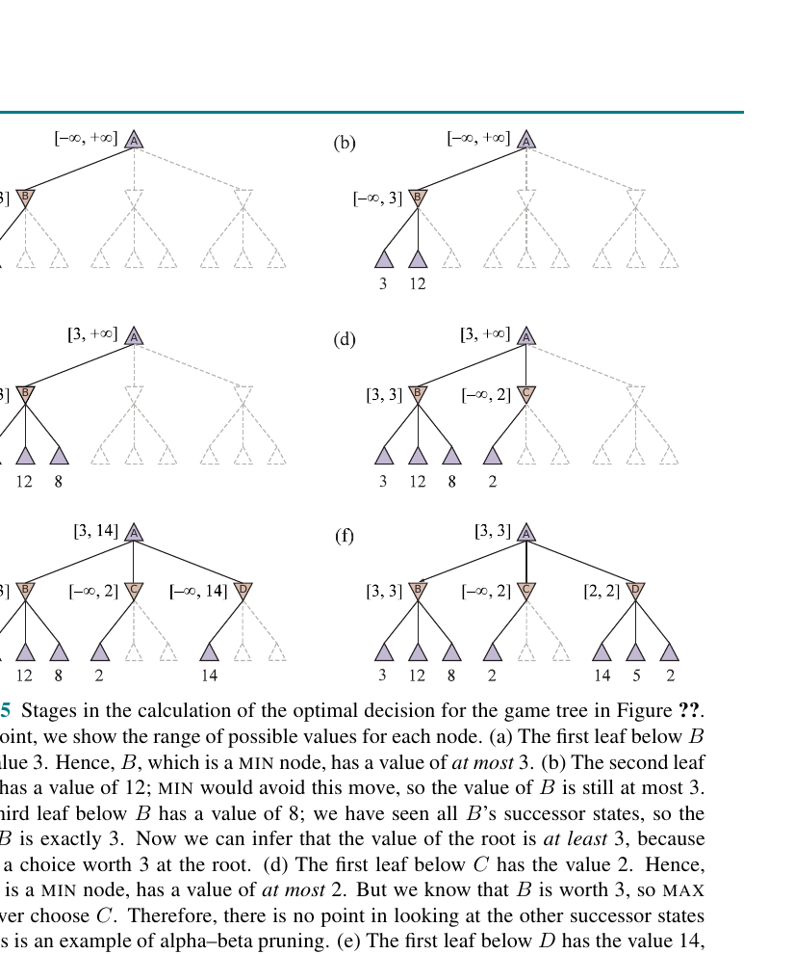
Visual Trace: Alpha-Beta on the Two-Ply Tree
The search can identify the same root decision without evaluating every leaf.
Core trace
• Evaluate B fully: B=3
• At C, first leaf is 2
• C can be at most 2
• MAX already has B=3, so C cannot win
• Prune remaining leaves under C
Teaching phrase
Once a child cannot beat the current best alternative, stop paying tuition for that branch.
Chapter 5 Figure 5.5: alpha-beta trace
COMP 469 | Adversarial Search and Games
Alpha-Beta Pruning
33
Notes:
Use the figure as a story. First MAX learns it has an option worth 3. Then it begins evaluating C. Because C is a MIN node and the first child gives 2, C cannot possibly rise above 2 for MAX. So MAX will never choose C.
Analogy: If you already have a guaranteed B grade, and a path can at best give you a C, stop investigating that path.
Gotcha: We are not pruning because C is bad in absolute terms; we prune because C is worse than an already available alternative.

Slide 34
Worked Pruning Moment: Why C Disappears
B gives MAX 3. C is already at most 2.
A
alpha=3
Reasoning
• B has exact value 3
• MAX root now has alpha = 3
• C is a MIN node
• First C child has value 2, so C <= 2
• Since C <= 2 < alpha, C cannot be chosen
B
3
C
<=2
D
?
3
12
8
2
X
X
What is pruned?
pruned
The other children under C may be 4 and 6, but MIN would choose 2 anyway.
COMP 469 | Adversarial Search and Games
Alpha-Beta Pruning
34
Notes:
This slide isolates the reasoning from the larger figure. Ask students to complete the inequality: if alpha = 3 and C can be at most 2, then C cannot improve MAX's choice.
Analogy: If a restaurant has already failed the health inspection at the entrance, you do not need to inspect the dessert menu.
Gotcha: Students sometimes ask, 'But what if a pruned leaf is 100?' Under C, MIN would still choose the already seen 2, so the high leaf cannot help MAX.

Slide 35
Why Alpha-Beta Is Correct
The pruned values are irrelevant to the root decision.
max( min(3,12,8), min(2,x,y), min(14,5,2) )
= max( 3, z, 2 ) where z = min(2,x,y) <= 2
= 3
Meaning
Student gotcha
The unknown values x and y cannot change the answer because the MIN node already has an option worth 2 for MAX.
Pruning is not approximation. Alpha-beta with the same depth and ordering returns the exact minimax move.
COMP 469 | Adversarial Search and Games
Alpha-Beta Pruning
35
Notes:
This slide gives a mathematical explanation after the intuition. Keep it short. The key is that z cannot exceed 2 because min(2,x,y) is never greater than 2.
Analogy: If the minimum of a set includes 2, adding bigger numbers to the set cannot make the minimum bigger.
Gotcha: Make sure students understand the word 'min' here. It is why x and y do not matter.

Slide 36
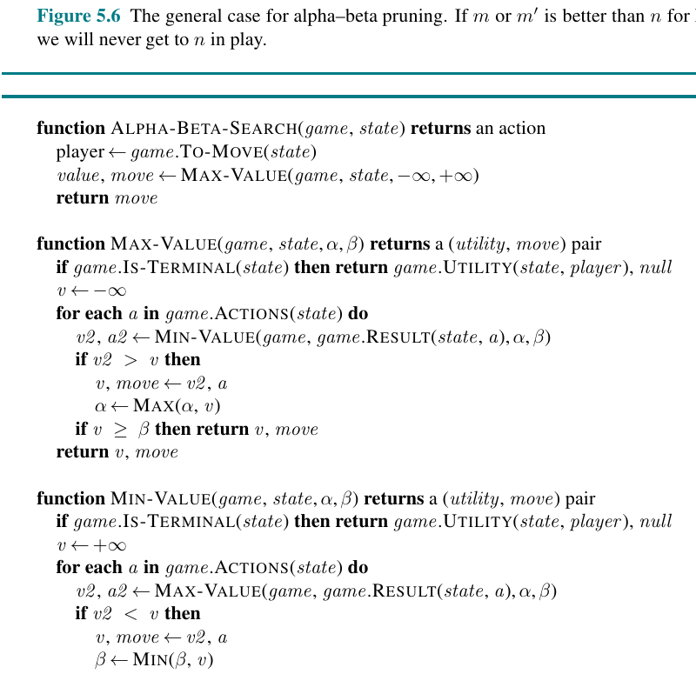
Alpha-Beta Search Pseudocode
Minimax plus two bounds: alpha and beta.
What changed from minimax?
• Pass alpha and beta recursively
• MAX updates alpha
• MIN updates beta
• Return early when bound is crossed
Implementation gotchas
• Initialize alpha = -infinity, beta = +infinity
• Do not swap players incorrectly
• Return value and move
• Pruning condition differs at MAX/MIN nodes
Chapter 5 Figure 5.7: alpha-beta algorithm
COMP 469 | Adversarial Search and Games
Algorithm
36
Notes:
Compare this to minimax. The recursive structure is the same; the bounds are the new ingredient.
Teaching move: Ask students to annotate the pseudocode with one color for MAX updates and another color for MIN updates.
Gotcha: In Python labs, the most common bug is not propagating updated alpha/beta into recursive calls or returning after a cutoff without preserving the best move.

Slide 37
Move Ordering Determines How Much You Prune
Alpha-beta is correct regardless of order, but speed depends heavily on order.
Bad ordering
Good ordering
Perfect ordering
Explore weak moves first. Bounds stay loose. Little pruning occurs.
Explore likely best moves first. Bounds tighten early. More branches vanish.
Can reduce effective work toward O(b^(m/2)), allowing roughly twice the search depth.
Heuristics: captures first, threats first, killer moves, iterative deepening ranks, transposition table values.
COMP 469 | Adversarial Search and Games
Move Ordering
37
Notes:
Students may think alpha-beta alone is enough. Explain that alpha-beta needs useful early bounds. Move ordering is how we get them.
Analogy: If you are looking for the best restaurant, visiting the most likely good restaurants first helps you eliminate weak candidates quickly.
Gotcha: Move ordering affects runtime, not the final result, assuming full alpha-beta search to the same depth.

Slide 38
Search Cost: Same Algorithm, Different Order
Good ordering turns pruning into a force multiplier.
Illustrative relative nodes examined
100%
Teaching point
Alpha-beta does not promise the same speed every time. The order of actions can be the difference between a small search and a huge one.
55%
28%
12%
Minimax
Alpha-beta
random order
Alpha-beta
good order
Alpha-beta
near-perfect
COMP 469 | Adversarial Search and Games
Move Ordering
38
Notes:
Make clear that the numbers are illustrative. The direction is the lesson: move ordering can dramatically reduce nodes.
Analogy: Search is like interviewing candidates. If you interview the strongest candidates first, you can reject weaker ones sooner.
Gotcha: Perfect ordering sounds circular because knowing the best move would already solve the problem. In practice, we use cheap approximations and previous searches.

Slide 39
Transposition Tables: Remember Reached Positions
Different move orders can lead to the same state. Cache the result.
W1
B1
A
What gets cached?
S
• State key or hash
• Depth searched
• Backed-up value
• Best move found
W2
B2
Why it helps
A repeated state can reuse the previous search result instead of exploring the same subtree again.
Chess engines rely heavily on transposition tables.
COMP 469 | Adversarial Search and Games
Move Ordering
39
Notes:
Explain transposition as repeated states through different move orders. This is common in games where actions in distant regions are independent.
Analogy: If two routes lead to the same airport gate, you do not need to re-evaluate every flight option after reaching the gate.
Gotcha: A transposition table is not just a visited set. It often stores value, depth, bounds, and best move, because the usefulness depends on search depth and context.

Slide 40
Iterative Deepening and Killer Moves
Use shallow searches to guide deeper searches.
Iterative deepening
Killer move heuristic
Practical value
• Search depth 1
• Record best move ordering
• Search depth 2 using that order
• Repeat until time runs out
Moves that caused cutoffs before are tried early in similar positions, because they may prune again.
This is how game engines make good decisions under a clock: always have the last completed depth available.
Search shallow first, then search deeper smarter.
Time management and move ordering reinforce each other.
COMP 469 | Adversarial Search and Games
Move Ordering
40
Notes:
Connect to Chapter 3 iterative deepening, then show why it is extra useful in games: it returns a usable move if time expires, and it produces move ordering data.
Analogy: Skim the exam first to find easy questions, then go deeper. The skim helps you allocate time and identify promising paths.
Gotcha: Iterative deepening is not wasted work in practice because the deepest level dominates the node count, and the improved ordering can more than repay the repeated shallow work.

Slide 41
SECTION 5.3
Heuristic Alpha-Beta Tree Search
Cut off deep search and estimate utility at non-terminal states.
cutoff
EVAL
risk
Stop by depth, time, or stability.
Estimate who is winning.
Evaluation can be fooled by tactics.
COMP 469 | CSU Channel Islands
41
Notes:
Transition note: Alpha-beta still cannot solve large games fully. This section makes search practical by adding heuristics.
Analogy: A commentator evaluates a game before it ends. They may be right often, but not always.
Gotcha: A fast, wrong evaluation can make the agent confidently choose losing moves.

Slide 42
Why Cut Off Search?
Alpha-beta helps, but real games are still too large.
Problem
Solution
Tradeoff
Even with pruning, chess and Go have far too many states to search to terminal outcomes in available time.
Stop at a depth limit or time limit, then evaluate the non-terminal state with a heuristic function.
The agent becomes faster but may make errors if the heuristic misunderstands the position.
Heuristic search asks: “Who seems to be winning from here?”
Not exact, but useful under time pressure.
COMP 469 | Adversarial Search and Games
Heuristic Alpha-Beta
42
Notes:
This section is the bridge from exact theory to practical engines. Exact minimax is elegant but often impossible.
Analogy: Watching a basketball game at halftime, you cannot know the final score, but you can estimate who is likely to win based on score, fouls, momentum, and injuries.
Gotcha: Heuristic evaluation is not utility. It estimates utility at cutoff states.

Slide 43
Heuristic Minimax
Replace terminal-only utility with a cutoff test and EVAL.
if IS-CUTOFF(s, d): return EVAL(s, MAX)
Cutoff test
EVAL(s,p)
Search behavior
• True at terminal states
• True at depth limit
• Can extend volatile states with quiescence search
• Fast to compute
• Correlated with actual chance of winning
• Equal to UTILITY at terminal states
Non-terminal cutoff states are treated as if they were leaves with estimated values.
COMP 469 | Adversarial Search and Games
Heuristic Alpha-Beta
43
Notes:
Have students compare this to minimax. The recursion is the same, but the base case expands from terminal states to cutoff states.
Analogy: If you cannot read the whole novel before class, you stop at a chapter and make an educated prediction about the ending.
Gotcha: A fixed depth cutoff can be dangerous if the position at that depth is unstable.

Slide 44
What Makes a Good Evaluation Function?
Fast, bounded, and correlated with winning.
Fast
Correct at terminal states
Correlated with outcome
Evaluation must be cheap enough to run at thousands or millions of cutoff nodes.
For terminal states, EVAL(s,p) must equal UTILITY(s,p).
Higher EVAL should generally mean better chances for the evaluated player.
Uses features
Beware interactions
Count and weight features such as material, mobility, threats, central control, king safety, or connect-four windows.
Feature contributions are not always independent. Modern agents often use nonlinear learned evaluation functions.
COMP 469 | Adversarial Search and Games
Evaluation Functions
44
Notes:
Make the evaluation function concrete. Ask students what features they would use for tic-tac-toe, Connect Four, or chess.
Analogy: A sports commentator uses features: score, time remaining, injuries, possession. The commentator is not simulating every future, but estimating strength.
Gotcha: More features do not automatically improve evaluation. Bad or slow features can hurt performance.

Slide 45
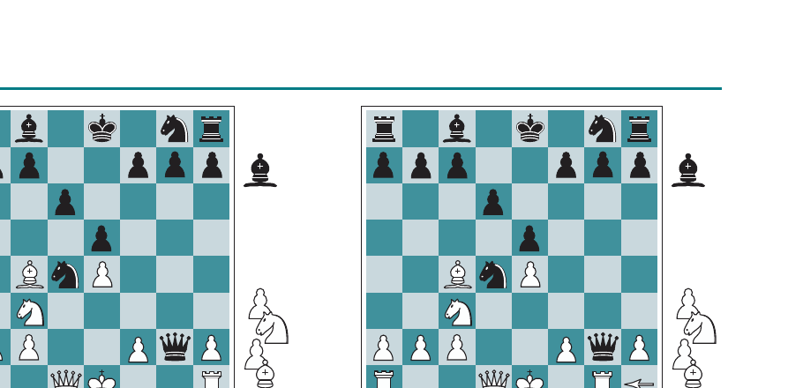
Chess Example: Material Is Useful but Incomplete
A simple count can miss tactical swings.
Material evaluation
• Pawn ≈ 1
• Knight or bishop ≈ 3
• Rook ≈ 5
• Queen ≈ 9
Teaching point
Material advantage may be misleading if an immediate tactic changes the board after the cutoff.
Chapter 5 Figure 5.8: two chess positions
Question for students
Why might a position that looks good by material count actually be losing?
COMP 469 | Adversarial Search and Games
Evaluation Functions
45
Notes:
Use the figure to introduce tactical instability. A naive material count might say Black is ahead, but a nearby capture can change everything.
Analogy: Judging a game at halftime based only on the score misses that the star player just got injured. A single upcoming event can dominate the evaluation.
Gotcha: Heuristic values are only as good as the features they see and the horizon they can reach.

Slide 46
Weighted Linear Evaluation
A classic approach: add up weighted features.
EVAL(s) = w1 f1(s) + w2 f2(s) + ... + wn fn(s)
Features f_i
Weights w_i
Limitation
• Material count
• Mobility
• Threats
• Center control
• King safety
• How important each feature is
• Can be hand-designed
• Can be learned from data
Simple addition assumes features combine independently, which is often false.
COMP 469 | Adversarial Search and Games
Evaluation Functions
46
Notes:
This is a direct bridge to machine learning. Features can be hand-crafted or learned.
Analogy: A course grade is often a weighted sum: exams, labs, participation, final project. But in games, features can interact in nonlinear ways.
Gotcha: A linear score can prefer a position with many small advantages while missing one decisive tactical weakness.

Slide 47
Connect Four Heuristic Example
Students can implement this in the Chapter 5 lab.
Possible features
• +100 for four in a row
• +10 for three plus empty
• +3 for two plus two empty
• +3 for center column control
• -80 for opponent immediate win
Why it works
Feature: center column + diagonal threat
The heuristic scores local patterns that are likely to become wins before the full game is searched.
COMP 469 | Adversarial Search and Games
Evaluation Functions
47
Notes:
This slide is very practical. Students can see that an evaluation function is not magic; it is a score over features.
Analogy: Connect Four evaluation is like scanning the board for 'almost wins' and 'almost losses.'
Gotcha: If the heuristic ignores opponent threats, the agent may happily build its own line while allowing the opponent to win immediately.

Slide 48
Quiescence Search: Do Not Evaluate During a Storm
Cut off only when the position is stable enough to estimate.
Non-quiescent state
Quiescent state
Search extension
A volatile position where a capture, forced win, or tactical swing is pending.
A stable position where immediate tactics are not likely to wildly change the evaluation.
If the cutoff position is volatile, search only relevant tactical moves until stability.
Never ask the scoreboard during the explosion.
Wait until the tactical smoke clears.
COMP 469 | Adversarial Search and Games
Evaluation Functions
48
Notes:
This is one of the best analogies in the chapter. Students immediately understand that evaluating during a forced capture sequence is unreliable.
Analogy: Do not judge traffic speed while cars are braking for an accident. Wait until traffic stabilizes.
Gotcha: Quiescence search is not unlimited full search. It is usually restricted to forcing or volatile moves, such as captures or checks in chess.

Slide 49
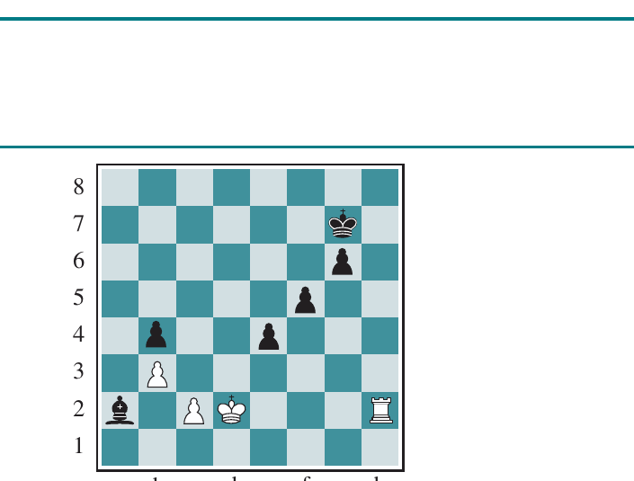
The Horizon Effect
A fixed search depth can hide inevitable damage just beyond the cutoff.
Problem
The agent finds delaying moves that push a loss beyond the search horizon, making bad moves look good.
Chess example
A doomed bishop may be temporarily protected by pawn checks, but the loss is only postponed.
Mitigation
Chapter 5 Figure 5.9: horizon effect
Use quiescence search, singular extensions, and better evaluation of threats.
COMP 469 | Adversarial Search and Games
Evaluation Functions
49
Notes:
Use the phrase 'pushed over the horizon.' Students know the horizon as the line beyond which you cannot see.
Analogy: A student with a deadline keeps doing tiny tasks to avoid starting the project. The problem has not disappeared; it has moved beyond today's view.
Gotcha: Increasing depth helps but does not eliminate the horizon effect. The agent may find longer delaying tactics.

Slide 50
Singular Extensions
Search deeper when one move is clearly forcing.
Normal cutoff
Singular situation
Purpose
Stop at depth d and call EVAL.
One move is clearly better or forced, so the line deserves extra depth.
Expose tactics that would otherwise be hidden just beyond the horizon.
Rule of thumb: spend extra search only where the position screams “look deeper here.”
COMP 469 | Adversarial Search and Games
Evaluation Functions
50
Notes:
Explain that not all nodes get extended. The point is to extend lines where a move is unusually forcing or clearly superior.
Analogy: If a medical test shows a major anomaly, the doctor orders a deeper follow-up. They do not order every possible test for every patient.
Gotcha: Extensions increase depth, so they must be selective. Otherwise the search can blow up.

Slide 51
Forward Pruning: Fast but Risky
Unlike alpha-beta, forward pruning can remove the best move by mistake.
Alpha-beta pruning
Forward pruning
Beam search example
Safe: removes branches that cannot affect the minimax value.
Risky: removes moves that look poor before proving they are irrelevant.
Only search the top n moves by evaluation at each ply. Efficient, but may prune a hidden tactic.
Forward pruning buys speed with a possibility of error.
This is Shannon Type B search.
COMP 469 | Adversarial Search and Games
Forward Pruning
51
Notes:
Stress the difference between safe and risky pruning. Alpha-beta is exact. Forward pruning is approximate.
Analogy: Alpha-beta is skipping a route proven slower. Forward pruning is ignoring a road because it looks ugly on the map; it might still be the shortcut.
Gotcha: Students may call every cutoff alpha-beta pruning. Use the word 'safe' as the distinction.

Slide 52
PROBCUT and Late Move Reduction
Practical engines balance risk and speed.
PROBCUT
Late Move Reduction
Recovery mechanism
Do a shallow search and use past statistics to estimate whether deeper search is unlikely to matter.
If move ordering is good, later moves are less likely to be best. Search them to reduced depth first.
If a reduced-depth search looks promising, rerun it with full depth.
Modern search engines are not pure textbook minimax; they are engineered systems full of safe and risky accelerations.
COMP 469 | Adversarial Search and Games
Forward Pruning
52
Notes:
This slide helps students see how theoretical algorithms become practical engines.
Analogy: A physician may use a quick screening test before ordering expensive imaging. If the screen is worrying, they escalate.
Gotcha: These techniques are not always correct in the mathematical minimax sense. They are engineering choices with empirical performance tradeoffs.

Slide 53
SECTION 5.4
Monte Carlo Tree Search
Estimate move quality by building a partial tree through repeated simulated play.
selection
simulation
backpropagation
Walk toward promising or underexplored nodes.
Play to the end to sample an outcome.
Update statistics along the path.
COMP 469 | CSU Channel Islands
53
Notes:
Transition note: MCTS gives a different way to ask “who is winning?” Instead of hand-coding EVAL, it gathers evidence from playouts.
Analogy: Alpha-beta is like expert analysis; MCTS is like repeated experimentation.
Gotcha: MCTS is not pure random play. The tree policy focuses simulations over time.

Slide 54
MCTS Motivation: When Evaluation Is Hard
Estimate values by playing many fast games to the end.
Problem with Go-like games
MCTS idea
Anytime behavior
Huge branching factor and subtle board influence make hand-crafted evaluation difficult.
Instead of expert scoring, simulate many playouts and use observed win rates.
The longer it runs, the better its statistics become; it can return a move when time expires.
If you cannot evaluate the position, try living many possible futures.
MCTS learns from simulated experience.
COMP 469 | Adversarial Search and Games
Monte Carlo Tree Search
54
Notes:
Introduce MCTS as simulation-based evaluation. It is not random guessing; it builds a tree biased toward promising moves.
Analogy: If you cannot judge a recipe from ingredients alone, cook it many times with variations and see which version wins taste tests.
Gotcha: Pure random rollouts can be noisy. Strong MCTS systems improve simulation, selection, or both.

Slide 55
The Four-Step MCTS Loop
Selection, expansion, simulation, backpropagation.
1. Selection
2. Expansion
Follow the tree using a rule like UCB/UCT.
Add one or more new child nodes.
4. Backpropagation
3. Simulation
Update win/visit counts along the path.
Run a playout to a terminal result.
Repeat until time runs out; choose the move with the best visit/win statistics.
COMP 469 | Adversarial Search and Games
Monte Carlo Tree Search
55
Notes:
Make students chant the four stages. The loop is the heart of MCTS.
Analogy: Explore a building by repeatedly choosing a hallway, opening a new door, walking randomly to see what happens, then updating your mental map.
Gotcha: Backpropagation in MCTS updates statistics, not neural-network gradients in this chapter context.

Slide 56
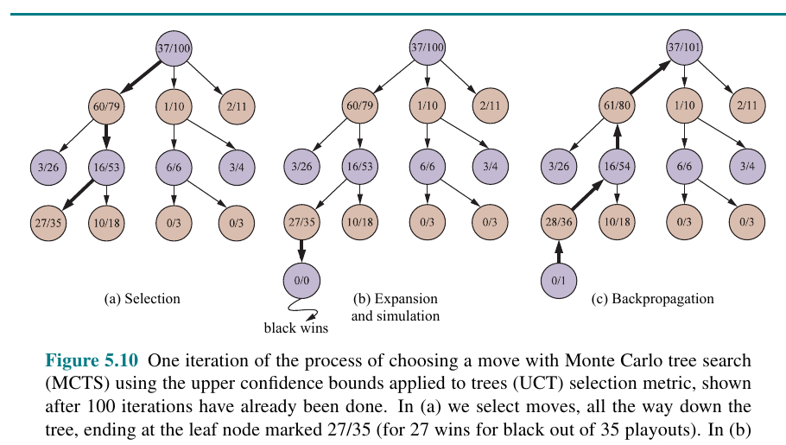
MCTS Visual: One Iteration
A simulated game result updates the path back to the root.
Read the counts
A node labeled 27/35 means 27 wins from 35 playouts. Counts guide future selection.
Backpropagation
After a rollout ends, every node on the selected path gets updated.
Class prompt
Which node becomes more attractive after the black win is backed up?
Chapter 5 Figure 5.10: MCTS selection, simulation, backpropagation
COMP 469 | Adversarial Search and Games
Monte Carlo Tree Search
56
Notes:
Use this figure to distinguish MCTS from minimax. Minimax backs up exact values from a complete search. MCTS backs up sample results from simulations.
Analogy: A restaurant review app updates ratings after each customer visit. MCTS updates move ratings after each simulated game.
Gotcha: Visit count matters. A high win rate from one rollout may be less reliable than a slightly lower win rate from hundreds of rollouts.

Slide 57
Selection: Exploration vs. Exploitation
UCT balances moves that look good with moves that need more evidence.
UCT(node) = win_rate + C * sqrt( ln(parent_visits) / node_visits )
Exploitation
Exploration
Tuning C
Choose nodes with high observed win rates.
Try nodes with low visit counts because they might be underestimated.
Higher C explores more; lower C exploits known good branches more aggressively.
Teaching phrase: “Trust the scoreboard, but keep scouting unvisited territory.”
COMP 469 | Adversarial Search and Games
Monte Carlo Tree Search
57
Notes:
Do not overdo the math. Students need the intuition: one term rewards success; the other rewards uncertainty.
Analogy: Choosing restaurants: revisit places you know are good, but occasionally try new places because your current favorite may not be best.
Gotcha: Students may think MCTS always chooses the highest win rate. It often chooses a less-visited node to gather information.

Slide 58
Simulation/Rollout: Playing to the End
Rollouts convert an unknown state into a sampled outcome.
Random rollout
Heuristic rollout
Learned rollout
Choose legal moves randomly until terminal state. Easy, but noisy.
Use simple domain rules to make simulations more realistic.
Use a model or policy network to guide moves, as in advanced systems.
A rollout is a cheap imagined future.
The value estimate is the average of many futures, not one story.
COMP 469 | Adversarial Search and Games
Monte Carlo Tree Search
58
Notes:
Explain why one rollout is not enough. Randomness creates variance. MCTS gains power from many samples.
Analogy: Polling one voter tells you little; polling many voters gives an estimate.
Gotcha: Bad rollouts can bias MCTS. Pure randomness can miss strategic patterns in games where random play is unrealistic.

Slide 59
Backpropagation: Updating the Tree
Each simulation teaches every node on the selected path.
37/101
Before rollout
Counts summarize previous simulations.
61/80
16/54
After rollout
If the simulated winner is MAX, increment wins and visits for MAX-favorable nodes on the path.
0/1
Final decision
Often choose the root child with the most visits, not necessarily the highest raw win rate.
COMP 469 | Adversarial Search and Games
Monte Carlo Tree Search
59
Notes:
This slide clarifies what backpropagation means in MCTS. The result travels back up the path, changing future selection.
Analogy: After exploring a trail, you update every signpost along the route with what you learned.
Gotcha: Do not confuse MCTS backpropagation with neural-network training. Here it is just updating counts and rewards in tree nodes.

Slide 60
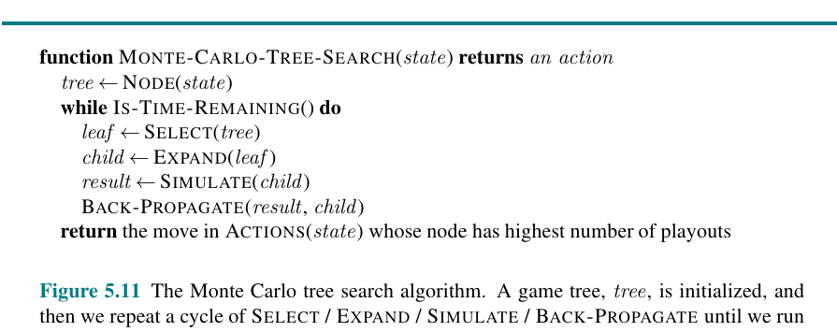
MCTS Pseudocode
Repeat the four-stage loop until time runs out.
Why return most playouts?
Visit count is a robust signal: it reflects both value and confidence accumulated during selection.
Anytime property
The algorithm can run for 1 second or 1 hour; more time usually improves the move recommendation.
Chapter 5 Figure 5.11: Monte Carlo tree search algorithm
Lab connection
Students can inspect how visit counts and win rates change as simulations increase.
COMP 469 | Adversarial Search and Games
Algorithm
60
Notes:
Compare the MCTS pseudocode to alpha-beta. Alpha-beta is depth-first deterministic backup. MCTS is repeated sampling and statistical backup.
Analogy: Alpha-beta is solving a proof tree; MCTS is running experiments.
Gotcha: MCTS still builds a tree. It is not just flat random simulation from the root.

Slide 61
Alpha-Beta vs. MCTS
Two different answers to limited computation time.
Alpha-beta
MCTS
• Needs a useful evaluation function
• Works well with moderate branching factor
• Pruning is exact
• Classic for chess-like games
• Uses simulations to estimate values
• Good when evaluation is hard
• Statistical and anytime
• Classic for Go-like games and many planning settings
Rule of thumb: If you can evaluate states well, alpha-beta is powerful. If you can simulate outcomes well, MCTS is powerful.
COMP 469 | Adversarial Search and Games
Algorithm Choice
61
Notes:
Use this as an algorithm selection slide. This helps students synthesize instead of memorizing algorithms independently.
Analogy: Alpha-beta is like an expert judge scoring positions. MCTS is like a scientist running many trials.
Gotcha: Modern systems often combine both ideas with learned evaluations and simulation/search hybrids.

Slide 62
Case Study: From Deep Blue to AlphaGo
Game AI moved from brute-force alpha-beta to search guided by learned models.
Deep Blue
AlphaGo
Lesson
Chess. Specialized hardware plus highly optimized search defeated Garry Kasparov in 1997.
Go. MCTS combined with policy/value neural networks defeated Lee Sedol 4-1 in 2016.
Search did not disappear. It became integrated with learning.
References: ibm.com/history/deep-blue | deepmind.google/research/alphago/
COMP 469 | Adversarial Search and Games
Case Study
62
Notes:
Give the historical arc: Deep Blue showed the power of engineered chess search; AlphaGo showed the power of combining search with learning.
Analogy: Early systems used a strong calculator and expert rules. Later systems added experience from self-play and learned intuition.
Gotcha: Do not tell students AlphaGo was 'just neural networks.' Search remained central through MCTS.

Slide 63
SECTION 5.5
Stochastic Games
Chance events add probability-weighted averaging to game-tree search.
decision nodes
chance nodes
scale issue
MAX and MIN still choose.
Random events average.
Heuristic values must be calibrated.
COMP 469 | CSU Channel Islands
63
Notes:
Transition note: Now the environment includes randomness, such as dice or shuffled cards. The opponent still matters, but so does probability.
Analogy: Some branches are chosen by players; some are rolled by dice.
Gotcha: Do not treat chance nodes as MIN nodes. Bad luck is not an adversary.

Slide 64
Stochastic Games Add Chance Nodes
Dice, cards, and random events require expected values.
MAX node
MIN node
CHANCE node
Choose the child with maximum value.
Choose the child with minimum MAX value.
Compute a probability-weighted average of child values.
EXPECTIMINIMAX(chance) = sum over outcomes r of P(r) * value(result after r)
COMP 469 | Adversarial Search and Games
Stochastic Games
64
Notes:
Introduce chance nodes as a third kind of node. They do not optimize; they average by probability.
Analogy: If MAX and MIN are decision-makers, chance is the dice roller. It does not prefer a side.
Gotcha: At chance nodes, do not take max or min. Use expected value.

Slide 65
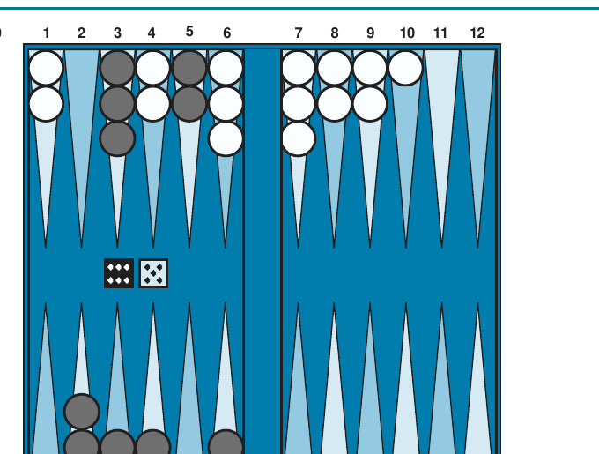
Backgammon: A Classic Stochastic Game
Players choose moves after dice rolls create possible actions.
Why chance matters
• Dice determine available moves
• Same board can lead to many chance outcomes
• A move is judged by expected utility over dice
Teaching analogy
Choosing a backgammon move is like making a plan before knowing tomorrow’s weather probabilities.
Chapter 5 Figure 5.12: typical backgammon position
COMP 469 | Adversarial Search and Games
Stochastic Games
65
Notes:
Backgammon is a useful example because chance is explicit and unavoidable. Students can see why minimax alone is not sufficient.
Analogy: You choose a route knowing traffic probabilities, not exact traffic. The best route may not be best in every possible traffic condition, but it has the best expected result.
Gotcha: Chance does not make the opponent random. A stochastic game can have both chance nodes and adversarial MIN/MAX nodes.

Slide 66
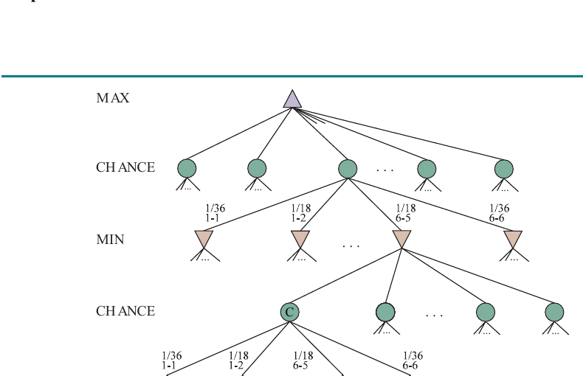
Expectiminimax Tree Structure
The tree alternates decisions and random outcomes.
Node types
• Triangles: MAX or MIN choices
• Circles: chance outcomes
• Probabilities label chance edges
• Values back up by max, min, or average
Complexity
Chance multiplies the branching factor. Alpha-beta is less effective because averages require more information.
Chapter 5 Figure 5.13: stochastic game tree
COMP 469 | Adversarial Search and Games
Stochastic Games
66
Notes:
Point to a chance node and ask what operation it performs. Students should answer: weighted average.
Analogy: Decision nodes are choices; chance nodes are lotteries.
Gotcha: Alpha-beta pruning depends on bounds and deterministic choices. Chance nodes make pruning harder because unexamined outcomes can change averages.

Slide 67
Worked Example: Expected Value
A risky action can beat a safe action depending on probabilities.
Action A: safe
Action B: risky
MAX chooses
50% chance of 6
50% chance of 6
Expected value = 6
90% chance of 3
10% chance of 40
Expected value = 6.7
Action B by expected value, even though most individual outcomes are worse.
B = 0.9 × 3 + 0.1 × 40 = 2.7 + 4 = 6.7
COMP 469 | Adversarial Search and Games
Stochastic Games
67
Notes:
This example is deliberately simple and memorable. It shows why expectation can prefer a risky move.
Analogy: A lottery-like investment may have a higher expected value but also more variance.
Gotcha: Expected value is not the same as most likely outcome. Action B most likely gives 3, yet expected value is 6.7.

Slide 68
Heuristic Scale Matters in Stochastic Games
Averages are sensitive to the numerical scale.
Minimax
Expectiminimax
Any order-preserving transformation usually keeps choices the same because only comparisons matter.
Changing scores changes averages, so decisions can change.
Rule: EVAL should be linearly related to the actual expected utility or win probability.
COMP 469 | Adversarial Search and Games
Stochastic Games
68
Notes:
This is subtle but important. In minimax, the exact spacing between values often does not matter. In expected value calculations, spacing matters because numbers are averaged.
Analogy: Letter grades preserve order, but you cannot average A, B, and C meaningfully unless you map them to a calibrated numerical scale.
Gotcha: A heuristic that is fine for alpha-beta may be inappropriate for expectiminimax if it is not calibrated.

Slide 69
SECTION 5.6
Partially Observable Games
When the full state is hidden, rational play must reason over beliefs and information.
hidden state
belief state
strategic information
Cards, pieces, or intentions may be unknown.
A set or distribution of possible worlds.
Actions can reveal, hide, or mislead.
COMP 469 | CSU Channel Islands
69
Notes:
Transition note: Hidden information changes the nature of planning. You do not choose based on one state; you choose based on a belief about possible states.
Analogy: Playing poker is not chess with more rules. It is a different reasoning problem because you must model what others know and believe.
Gotcha: Guessing one hidden state and solving it as a perfect-information game can be deeply misleading.

Slide 70
Partially Observable Games
When you cannot see the full state, the node is a belief state.
Perfect information
Imperfect information
Belief state
Both players see the complete state: chess, checkers, Go.
Some state variables are hidden: poker hands, Battleship ships, Kriegspiel pieces.
The set or distribution of actual states consistent with what the agent has observed.
You do not plan from one board; you plan from a cloud of possible boards.
That cloud changes after every observation and action.
COMP 469 | Adversarial Search and Games
Partially Observable Games
70
Notes:
Use poker as the intuitive example. You know your own cards and the public cards, but not the opponent's hidden cards.
Analogy: Driving in fog: you do not know exactly where every car is, but you maintain a set of plausible possibilities.
Gotcha: Partial observability is not the same as stochasticity. Hidden information may already be fixed, just unknown to you.

Slide 71
Analogies for Hidden Information
The challenge is reasoning under strategic uncertainty.
Poker
Battleship
Security games
Hidden cards + betting actions. Moves communicate information and may deceive.
Hidden ship locations. Shots are both attacks and information-gathering actions.
Defender and attacker may hide capabilities, targets, and intentions.
In hidden-information games, an action can be valuable because of what it reveals, not only because of immediate reward.
COMP 469 | Adversarial Search and Games
Partially Observable Games
71
Notes:
This slide broadens students' intuition. A move in an imperfect-information game can attack, defend, reveal, hide, or bluff.
Analogy: Asking a question in a negotiation may be useful because of the answer it elicits, even if it does not directly change the deal.
Gotcha: Standard minimax on a guessed state ignores information-gathering and bluffing value.

Slide 72
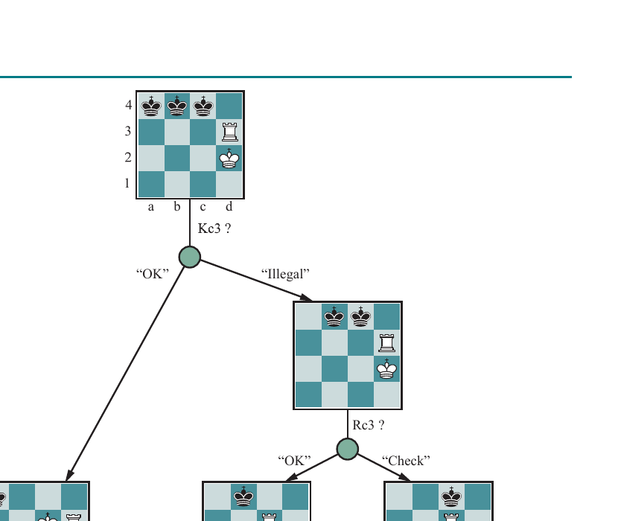
Kriegspiel: A Belief-State Search Tree
The agent reasons over possible boards instead of one visible board.
What the tree shows
• Agent proposes a move
• Referee reports whether it is legal or not
• Belief state narrows after observations
• Probing moves gather information
Teaching point
The right action may be a question disguised as a move.
Chapter 5 Figure 5.15: belief-state search in Kriegspiel
COMP 469 | Adversarial Search and Games
Partially Observable Games
72
Notes:
Explain Kriegspiel as chess without seeing the opponent's pieces. The referee tells legality and captures, which updates beliefs.
Analogy: Playing chess in a dark room while an umpire tells you whether a move is legal. You learn by attempting moves.
Gotcha: Students may try to pick a single most likely board. But the agent must consider all plausible boards, especially if errors are costly.

Slide 73
The Determinization Trap
Solving a guessed perfect-information game can be misleading.
Determinization
Why tempting?
Why dangerous?
Sample or guess hidden information, then run ordinary minimax on that fully specified state.
It reuses existing search code and is simple to implement.
It ignores information value, bluffing, and strategies that work across many possible hidden states.
Averaging perfect-information answers is not the same as solving an imperfect-information game.
Hidden information changes the kind of strategy you need.
COMP 469 | Adversarial Search and Games
Partially Observable Games
73
Notes:
This is an advanced but important lesson. Many beginner agents for card games make this mistake.
Analogy: If you guess your exam questions and study only those, you may perform well if your guess is right but fail across the full uncertainty set.
Gotcha: Randomly sampling hidden states can help as an approximation, but it is not a complete solution to strategic hidden information.

Slide 74
Mixed Strategies and Bluffing
Sometimes being predictable is exploitable.
Pure strategy
Mixed strategy
Bluffing
Always choose the same action in the same information state.
Choose among actions probabilistically to avoid exploitation.
An action can manipulate the opponent’s beliefs, not just the physical game state.
Poker lesson: If you only bet with strong hands, opponents learn to fold. If you always bluff, opponents learn to call.
COMP 469 | Adversarial Search and Games
Partially Observable Games
74
Notes:
This slide connects game search to game theory. In hidden-information games, optimal strategies may randomize.
Analogy: Rock-paper-scissors. A deterministic strategy is easy to exploit once discovered. Randomization can be rational.
Gotcha: Random does not mean irrational. A carefully chosen probability distribution can be optimal.

Slide 75
SECTION 5.7
Limitations of Game Search
No search method escapes modeling assumptions, computational limits, and approximation risk.
complexity
approximation
strategic adaptation
The tree can be too large.
Heuristics and samples can be wrong.
Opponents exploit weaknesses.
COMP 469 | CSU Channel Islands
75
Notes:
Transition note: This final section helps students become engineers, not just algorithm memorizers. They need to know when an algorithm might fail.
Analogy: Every search algorithm is a flashlight. It illuminates part of the future, but not all of it.
Gotcha: More compute helps, but bad modeling assumptions can still produce bad decisions.

Slide 76
Limitations of Game Search Algorithms
Every search method makes assumptions or tradeoffs.
Exponential growth
Heuristic error
Horizon effect
State trees explode with branching factor and depth.
Cutoff evaluation can misjudge unstable positions.
Delayed losses can hide beyond depth limits.
Sampling error
Hidden information
Exploitability
MCTS estimates can be noisy with too few rollouts.
Belief states and bluffing are hard to model.
A strategy optimized for one model may fail against adaptive opponents.
The art is choosing the right approximation for the game you actually have.
COMP 469 | Adversarial Search and Games
Limitations
76
Notes:
This slide is a synthesis. It prevents students from treating algorithms as magic. Every method has a context.
Analogy: A map can be accurate, fast to read, or detailed, but rarely all three at once. Search algorithms choose a compromise.
Gotcha: The best algorithm in a toy game may not be best in a real game with time limits, hidden information, or stochastic dynamics.

Slide 77
Complexity: The Branching Factor Tax
Each ply multiplies the number of possible futures.
Example
With branching factor b = 10, five ply gives about 100,000 leaf-level possibilities. Increase b or d, and search explodes.
This is why engines combine pruning, move ordering, cutoff tests, caching, and sampling.
10^1
10^2
10^3
10^4
10^5
d=1
d=2
d=3
d=4
d=5
COMP 469 | Adversarial Search and Games
Limitations
77
Notes:
Use this as the mathematical reality check. Even low branching factors become enormous quickly.
Analogy: A family tree branching by 10 at each generation becomes enormous in just a few generations.
Gotcha: Depth is measured in ply, not full moves. In chess, one move by White and one move by Black is two ply.

Slide 78
Evaluation Errors and Exploitability
A flawed evaluation function creates predictable weaknesses.
Blind spot
Overfitting
Adversarial adaptation
If EVAL ignores a feature, the agent may repeatedly choose states that are secretly bad.
An agent tuned for one opponent or style may fail against another.
Opponents can steer the game toward positions your search evaluates poorly.
A heuristic is a theory of what matters. Opponents can test that theory.
This is why evaluation is both technical and strategic.
COMP 469 | Adversarial Search and Games
Limitations
78
Notes:
This connects game search to modern AI concerns. If a model has blind spots, adversaries can exploit them.
Analogy: If a basketball defense always overprotects the paint, an opponent shoots threes. They exploit the evaluation function.
Gotcha: A good average win rate may hide rare but catastrophic weaknesses.

Slide 79
Bridge to Chapter 5 Visual Labs
Use the notebooks to turn lecture ideas into executable search traces.
Lab 5A
Lab 5B
Minimax Tic-Tac-Toe game trees
Alpha-beta pruning and move ordering
Lab 5C
Lab 5D
Heuristic alpha-beta in Connect Four
MCTS and stochastic games
Lab 5E
Partially observable games and limitations
Suggested class flow: lecture concept -> visual trace -> notebook demo -> student modification.
COMP 469 | Adversarial Search and Games
Labs
79
Notes:
Use this slide to connect the lecture to the labs the students will run. Show a notebook briefly after each major lecture section.
Teaching sequence: Do not start with code. First trace the tree by hand. Then show that the code automates the same process.
Gotcha: Students may think visualization is separate from algorithm. Make them map each colored node or edge to a variable in the code: value, alpha, beta, visit count, belief state.

Slide 80
Suggested 110-Minute Class Plan
A practical teaching cadence for a full class meeting.
0-15 min
15-35 min
35-55 min
Motivation, game assumptions, formal API.
Minimax trace + student mini-exercise.
Alpha-beta pruning trace + move ordering.
55-75 min
75-95 min
95-110 min
Heuristic alpha-beta, EVAL, horizon effect.
MCTS + stochastic games.
Partial observability, limitations, quiz, lab bridge.
Optional adjustment: split after alpha-beta if you want a slower, code-heavy lab day.
COMP 469 | Adversarial Search and Games
Instructor Plan
80
Notes:
This is for you as the instructor. You can hide it from students or keep it as a pacing slide.
Suggestion: For students new to recursion, spend more time on minimax and alpha-beta traces and defer MCTS details to the lab.
Gotcha: Do not try to cover every advanced variant deeply in one session. Emphasize algorithm selection and conceptual differences.

Slide 81
Common Student Gotchas
Address these explicitly before students code.
MAX at every level
Using average in minimax
Confusing utility and EVAL
Forgetting MIN makes the opponent cooperate.
Minimax uses choice, not probability.
Utility is terminal; EVAL estimates non-terminal states.
Pruning changes answer
Ignoring move ordering
Single hidden-state guess
Alpha-beta should return same minimax answer.
Correct but slow alpha-beta can look broken.
Partial observability requires belief reasoning.
If students can explain these mistakes, they understand the chapter.
COMP 469 | Adversarial Search and Games
Student Gotchas
81
Notes:
Use this slide before the lab. It will save many debugging questions.
Teaching move: Ask students to predict which gotcha they are most likely to make. Then tell them to check for that when debugging.
Gotcha for instructor: If a student's algorithm seems too good, it may be because MIN is choosing max or because terminal tests are wrong.

Slide 82
Quick Quiz: Check for Understanding
Use as exit ticket, group discussion, or exam practice.
Q1
Q2
Q3
At a MIN node with children 7, 2, 5, what value backs up?
Does alpha-beta pruning change the minimax value?
What is the difference between UTILITY and EVAL?
Q4
Q5
Q6
At a chance node, do we choose max, min, or average?
Why can a single guessed poker hand be a bad model?
Name one cause of the horizon effect.
COMP 469 | Adversarial Search and Games
Retrieval Practice
82
Notes:
Answers: Q1 = 2. Q2 = no, assuming correct alpha-beta with same depth. Q3 = UTILITY is exact terminal payoff; EVAL estimates non-terminal cutoff states. Q4 = probability-weighted average. Q5 = it ignores belief states, information gathering, and bluffing. Q6 = fixed depth cutoff hiding an inevitable event beyond the horizon.
Teaching move: Have students answer individually first. Then ask them to justify answers with one sentence.
Gotcha: A correct numeric answer without explanation may hide weak understanding.

Slide 83
Algorithm Selection Cheat Sheet
Match the algorithm to the game structure and resource constraints.
Small deterministic perfect-info game
Minimax
Exact if tree is small
Larger deterministic perfect-info game
Alpha-beta + ordering
Same answer, fewer nodes
Huge game with useful features
Heuristic alpha-beta
Depth-limited practical play
Huge game with hard evaluation
MCTS
Use simulation statistics
Game with dice/shuffling
Expectiminimax
Average chance outcomes
Hidden information game
Belief-state / game-theoretic methods
Reason over possible states
COMP 469 | Adversarial Search and Games
Synthesis
83
Notes:
This is a strong review slide. Ask students to give an example game for each row.
Teaching move: Cover the middle column and ask students to fill it in.
Gotcha: Real systems may combine methods. This table is a teaching guide, not a rigid taxonomy.

Slide 84
References and Helpful URLs
Share these with students for review and further exploration.
AIMA textbook site
AIMA Python code
https://aima.cs.berkeley.edu/
https://github.com/aimacode/aima-python
AIMA Python games module
Berkeley CS188 AI course
https://aima.cs.berkeley.edu/python/games.html
https://inst.eecs.berkeley.edu/~cs188/
IBM Deep Blue history
Google DeepMind AlphaGo
https://www.ibm.com/history/deep-blue
https://deepmind.google/research/alphago/
Primary source for this lecture: Chapter 5, Adversarial Search and Games, plus the provided Chapter 5 images and visual labs.
COMP 469 | Adversarial Search and Games
References
84
Notes:
These URLs are useful for students who want examples, pseudocode, or historical context. The AIMA Python repository is especially helpful because it contains executable reference implementations.
Teaching note: Encourage students to read code after they understand the tree traces. Code is easier to understand once the visual process is clear.
Gotcha: Online implementations may use different utility conventions, such as win=1/draw=0/loss=-1 or win=1/draw=0.5/loss=0. Always check the convention.

Slide 85
Chapter 5 Wrap-Up
Search becomes strategy
when another agent pushes back.
Minimax gives the ideal. Alpha-beta saves work. Heuristics handle time. MCTS samples futures. Stochastic and partially observable games force us to model uncertainty.
Questions?
85
Notes:
Close by returning to the big idea: Chapter 5 is not merely about games; it is about rational action when other agents have conflicting goals.
Ask students to complete this sentence on paper: 'The main difference between Chapter 3 search and Chapter 5 search is...'
Good answer: Chapter 3 searched for a path in a passive environment; Chapter 5 searches through choices made by multiple agents, including adversarial choices.

